Slide 1
Bonferroni or Holm or Hochberg? Multiplicity adjustment method choice based on simulation

Slide 2

Multiplicity problems in clinical trials
Source of multiplicity in clinical trials
Multiple doses / treatments
Multiple endpoints
Interim analyses
Subgroup analyses
Different statistical models
Other
Type I error inflating
Prob(at least one positive hypothesis among k hypotheses| Null Hypotheses) = 1- prob(none positive | Null
Hypotheses) = 1- (1- α)^k > α

Slide 3
Multiplicity Guidelines
FDA guidance
Draft guidance on multiple endpoints in clinical trials (January 2017)
EMA guidance
Draft guideline on multiplicity issues in clinical trials (April 2017)
China CCTS 专家共识 (China Clinical Trial Statistics)
临床试验中多重性问题的统计学考虑 (January 2016)
Multiplicity guidance in NMPA CDE?

Slide 4
Recent review papers and tutorials
Dmitrienko, D’Agostino and Huque. (2013). Key multiplicity issues in clinical drug development
Dmitrienko and D’Agostino. (2013). Tutorial in Biostatistics: Traditional multiplicity adjustment methods in clinical trials
Alosh, Bretz and Huque (2014). Advanced multiplicity adjustment methods in clinical trials

Slide 5
Story starts…
When
Feb 2019, a China RM asked me to attend a CFDA meeting with her to answer the possible questions on statistical design/methods of a non-inferiority study
Why
I found the Bonferroni adjustment was used in the study to control familywise type I error rate when there may exist correlations between the two primary endpoints

Slide 6
An Example – DBT Study
DBT: 3D Digital Breast Tomosynthesis; MG: 2D Mammography; V-Preview: 2D reconstructed images
The primary endpoints are the conspicuity scores collected for:
(1) DBT+MG vs. MG (2) DBT+V-Preview vs.MG.
-2 = DBT+MG/DBT+V-Preview was clearly less conspicuous than MG
-1 = DBT+MG/DBT+V-Preview was slightly less conspicuous than MG
0= DBT+MG/DBT+V-Preview and MG exhibited similar conspicuity
+1= DBT+MG/DBT+V-Preview was slightly more conspicuous than MG
+2= DBT+MG/DBT+V-Preview was clearly more conspicuous than MG
Null Hypothesis 1：Median of conspicuity score of DBT + MG vs MG <= 0.5 (non-inferiority margin) ;
Null Hypothesis 2：Median of conspicuity score of DBT + V-Preview vs MG <= 0.5 (non-inferiority margin) ;
Success Criteria: At least one null hypothesis is rejected. And Bonferroni method is used to control familywise type I error rate.
Is the Bonferroni the most appropriate method for this study?
DBT + MG
MG
DBT + V-Preview

Slide 7
Bonferroni Method
Test each hypothesis at α/k level
Pr(at least one false positive)
<=Pr(H₁ false positive)+Pr (H₂ false positive)
= α/2 + α/2 = α
H1
H2
Correlation

Slide 8
Alternatives to Bonferroni Adjustment
Assume two hypotheses: H1 and H2, with two p-values p1 and p2. Assume p1<p2.
Pre-specified type I error is 0.05.
 | Bonferroni | Holm | Hochberg
Rejection Rule | Testing each test independently 1. If p1<=0.05/2, reject H1; 2. If p2<=0.05/2, reject H2; | Testing begins with the smallest p-value 1. If p1<=0.05/2, reject H1 and continue; Otherwise stop and accept all hypotheses; 2. If p2<=0.05, reject H2; Otherwise accept H2; | Testing begins with the largest p-value 1. If p2<=0.05, accept all hypotheses; Otherwise continue to P2; 2. If p2<=0.05/2, reject H1;
At-least-one win criteria | p1<=0.05/2 | p1<=0.05/2 | p2<=0.05 or p1<=0.05/2
Example 1 (p1 0.03, p2 0.04) | Accept H1 and H2 | Accept H1 and H2 | Reject H1 and H2
Example 2 (p1 0.02, p2 0.04) | Accept H2 and Reject H1 | Reject H1 and H2 | Reject H1 and H2
Bonferroni
Holm
Hochberg
P1<=0.025
Reject
H1
P1<=0.025
Reject
H1
P2<=0.05
Reject
H1, H2
P2<=0.025
Reject
H2
P2<=0.05
Reject
H2
P1<=0.025
Reject
H1

Slide 9
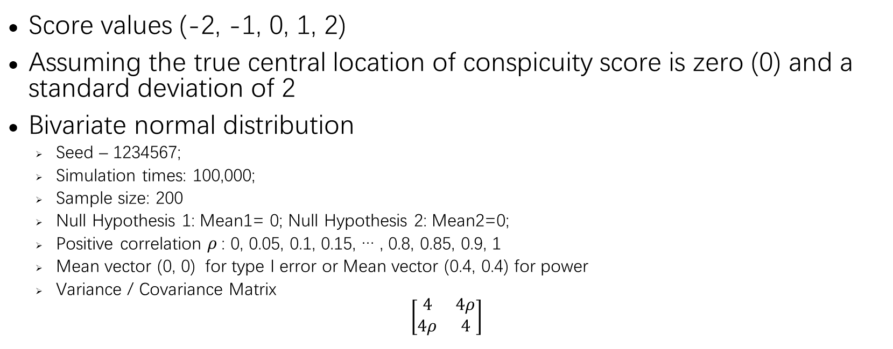
Simulation setting
Score values (-2, -1, 0, 1, 2)
Assuming the true central location of conspicuity score is zero (0) and a standard deviation of 2
Bivariate normal distribution
Seed – 1234567;
Simulation times: 100,000;
Sample size: 200
Null Hypothesis 1: Mean1= 0; Null Hypothesis 2: Mean2=0;
Positive correlation $ρ$: 0, 0.05, 0.1, 0.15, … , 0.8, 0.85, 0.9, 1
Mean vector (0, 0) for type I error or Mean vector (0.4, 0.4) for power
Variance / Covariance Matrix
$$\left[\begin{matrix}4 & 4ρ \\ 4ρ & 4\end{matrix}\right]$$

Slide 10
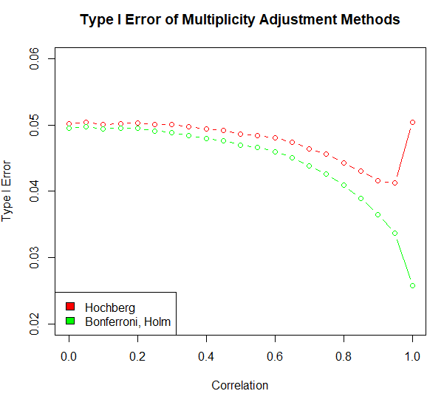
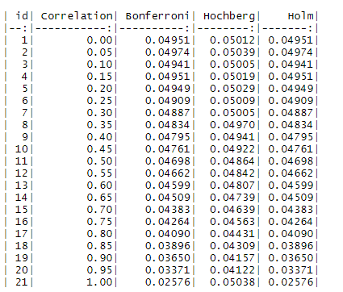
Familywise Type I Error

Slide 11
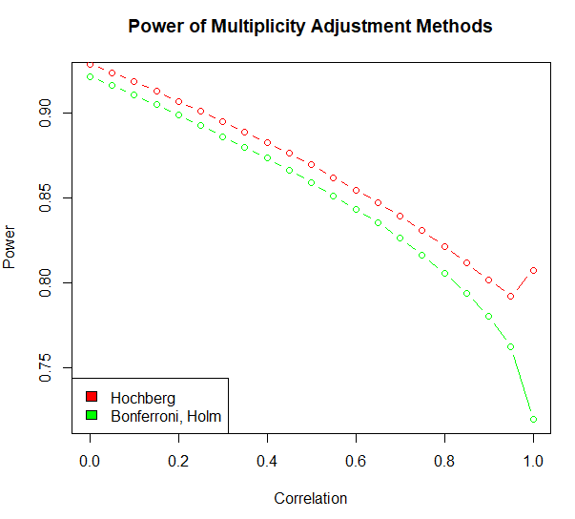
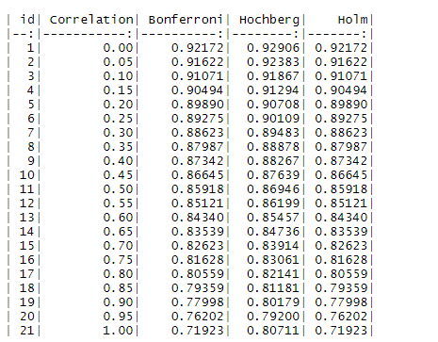
Power

Slide 12
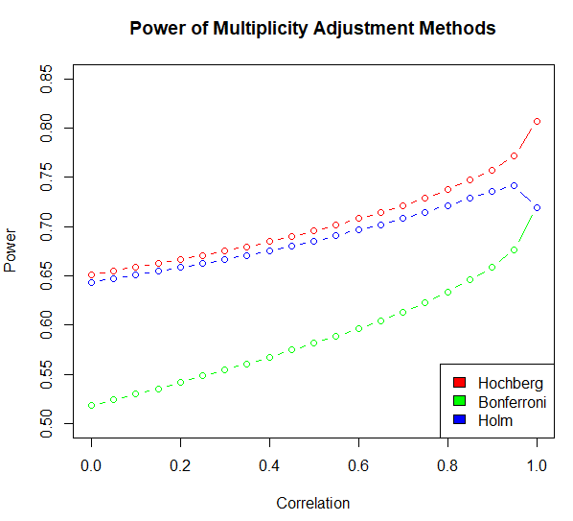
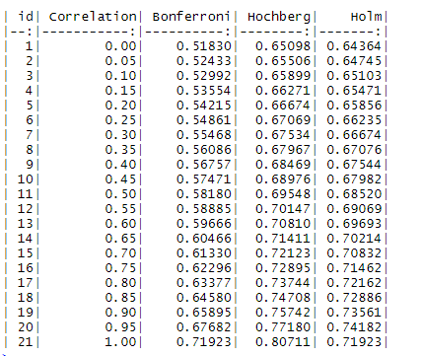
Power – two hypotheses rejected

Slide 13
Discussion
Holm adjustment may be the most appropriate method for this study
Correlation >= 0.35 - Hochberg adjustment
How to simulate bivariate (-2, -1, 0, 1, 2) distribution data
Simulation-based method choice

